Slide 1
Priority Queues

Slide 2
Introduction
Priority Queue
Data structure for storing a collection of prioritized elements
Supporting arbitrary element insertion
Supporting removal of elements in order of priority
So far, we covered “position-based” data structures
Stacks, queues, deques, lists, and even lists
Store elements at specific positions (linear or hierarchical)
Insertion and removal based on “position” (linear or hierarchical)
But, priority queue
Insertion and removal: priority-based
Question: how to express the priority of an element
Key (example: your student id)

Slide 3
Priority Queue ADT
A priority queue stores a collection of entries
Typically, an entry is a pair (key, value), where the key indicates the priority
Main methods of the Priority Queue ADT
insert(e) inserts an entry e (with an implicit associated key value)
removeMin() removes the entry with smallest key
Additional methods
min() returns, but does not remove, an entry with smallest key
size(), empty()
Applications:
Standby flyers
Auctions
Stock market

Slide 4
Total Order Relations (a topic of Discrete Math)
Keys in a priority queue can be arbitrary objects on which an order is defined
Two distinct entries in a priority queue can have the same key
Total ordering
Comparison rule should be defined for every pair of keys
Mathematical concept of total order relation ≤
Reflexive property: x ≤ x
Antisymmetric property: x ≤ y ∧ y ≤ x ⇒ x = y
Transitive property: x ≤ y ∧ y ≤ z ⇒ x ≤ z
Satisfying the above three properties ensures:
Never leading to a comparison contradiction

Slide 5
Example: Total order & Partial order
2D points with (x-coordinate, y-coordinate)
Define relation ‘>=’ based on x-first, and y-next
(4,3) >= (3,4), (3,5) >= (3,4)
Total ordering
What about defining relation ‘>=‘ based on both x and y
(4,3) >=(2,1), but (4,3) ??? (3,4)
Partial ordering
Comparison not defined for some objects
We assume that we define a comparison that leads to total ordering.

Slide 6
Priority Queue Sorting
We can use a priority queue to sort a set of comparable elements
Insert the elements one by one with a series of insert operations
Remove the elements in sorted order with a series of removeMin operations
The running time of this sorting method depends on the priority queue implementation
Algorithm PQ-Sort(S, C)
Input sequence S, comparator C for the elements of S
Output sequence S sorted in increasing order according to C
P ← priority queue with comparator C
while ¬S.empty ()
e ← S.front(); S.eraseFront()
P.insert (e, ∅)
while ¬P.empty()
e ← P.removeMin()
S.insertBack(e)

Slide 7
Sequence-based Priority Queue
Implementation with an unsorted list
Performance:
insert takes O(1) time since we can insert the item at the beginning or end of the sequence
removeMin and min take O(n) time since we have to traverse the entire sequence to find the smallest key
Implementation with a sorted list
Performance:
insert takes O(n) time since we have to find the place where to insert the item
removeMin and min take O(1) time, since the smallest key is at the beginning
4
5
2
3
1
1
2
3
4
5

Slide 8
Selection-Sort
Selection-sort is the variation of PQ-sort where the priority queue is implemented with an unsorted sequence
Running time of Selection-sort:
Inserting the elements into the priority queue with n insert operations takes O(n) time
Removing the elements in sorted order from the priority queue with n removeMin operations takes time proportional to
1 + 2 + …+ n
Selection-sort runs in O(n²) time

Slide 9
Selection-Sort Example
Sequence S Priority Queue P
Input: (7,4,8,2,5,3,9) ()
Phase 1
(a) (4,8,2,5,3,9) (7)
(b) (8,2,5,3,9) (7,4)
.. .. ..
(g) () (7,4,8,2,5,3,9)
Phase 2
(a) (2) (7,4,8,5,3,9)
(b) (2,3) (7,4,8,5,9)
(c) (2,3,4) (7,8,5,9)
(d) (2,3,4,5) (7,8,9)
(e) (2,3,4,5,7) (8,9)
(f) (2,3,4,5,7,8) (9)
(g) (2,3,4,5,7,8,9) ()

Slide 10
Insertion-Sort
Insertion-sort is the variation of PQ-sort where the priority queue is implemented with a sorted sequence
Running time of Insertion-sort:
Inserting the elements into the priority queue with n insert operations takes time proportional to
1 + 2 + …+ n
Removing the elements in sorted order from the priority queue with a series of n removeMin operations takes O(n) time
Insertion-sort runs in O(n²) time

Slide 11
Insertion-Sort Example
Sequence S Priority queue P
Input: (7,4,8,2,5,3,9) ()
Phase 1
(a) (4,8,2,5,3,9) (7)
(b) (8,2,5,3,9) (4,7)
(c) (2,5,3,9) (4,7,8)
(d) (5,3,9) (2,4,7,8)
(e) (3,9) (2,4,5,7,8)
(f) (9) (2,3,4,5,7,8)
(g) () (2,3,4,5,7,8,9)
Phase 2
(a) (2) (3,4,5,7,8,9)
(b) (2,3) (4,5,7,8,9)
.. .. ..
(g) (2,3,4,5,7,8,9) ()

Slide 12
Comparator
Another design method

Slide 13
How to define order for any object? (1)
Integer, float, double
Quite clear on how to define “order”
Student: id, sex, department
S1 is less than S2? In what sense?
Flight Passengers: airplane number, seat number, sex
P1 is less than P2? In what sense?
How to design “comparison logic” in a programming language?
What design is good?

Slide 14
Design 1: Separate Design
Different Priority Queue based on the element type and the manner of comparing elements
PQ_Int, PQ_Student, PQ_XXX
Simple, but not general
Many copies of the same code
PQ_int
PQ_student
i1
i2
s1
s2
i3
s3
integer comparison
student comparison

Slide 15
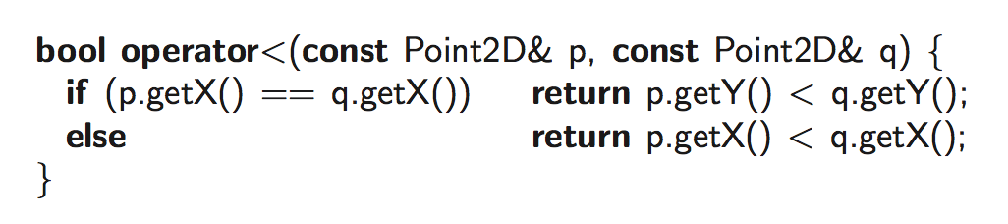
Design 2: Template and Overloading (2)
General enough for many situations
But,
Cannot have multiple comparison methods for the same type
What about comparison based on y-first, and x-next?
Even for the same data type, we want to apply different comparison methods A or B, depending on the situations
PQ template
<
PQ<int>
PQ<student>
i1
i2
s1
s2
i3
s3
integer comparison: “overload <“
student comparison:
“overload <“

Slide 16
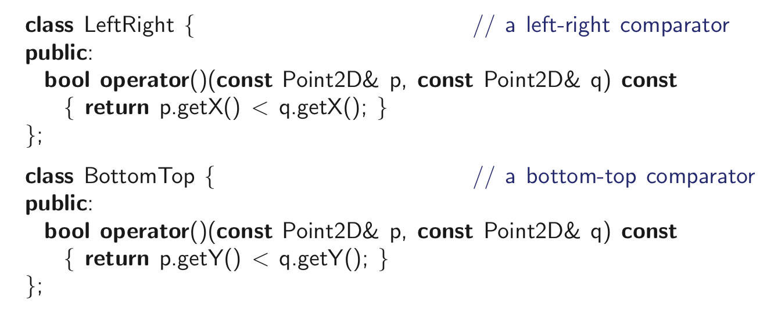
Design 3: Separating Comparator (1)
2D points: Point2D p, Point 2: q
Sometimes we want either of X-based comparison, Y-based comparison
Idea
Define a comparator class, e.g., “LeftRight” (x-based) and “BottomTop” (y-based)
Overload “()” operator

Slide 17
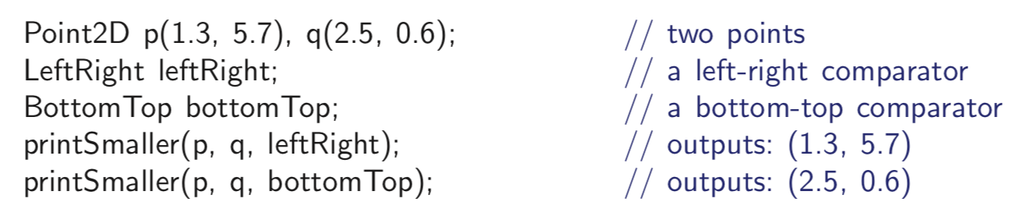
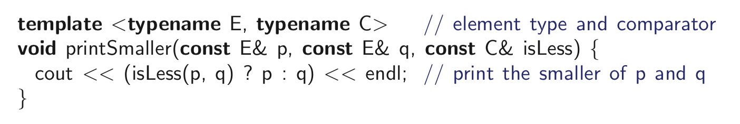
Design 3: Separating Comparator (2)
PQ<int>
PQ<student>
i1
i2
s1
s2
i3
s3
c1
c2
c’1
c’2

Slide 18
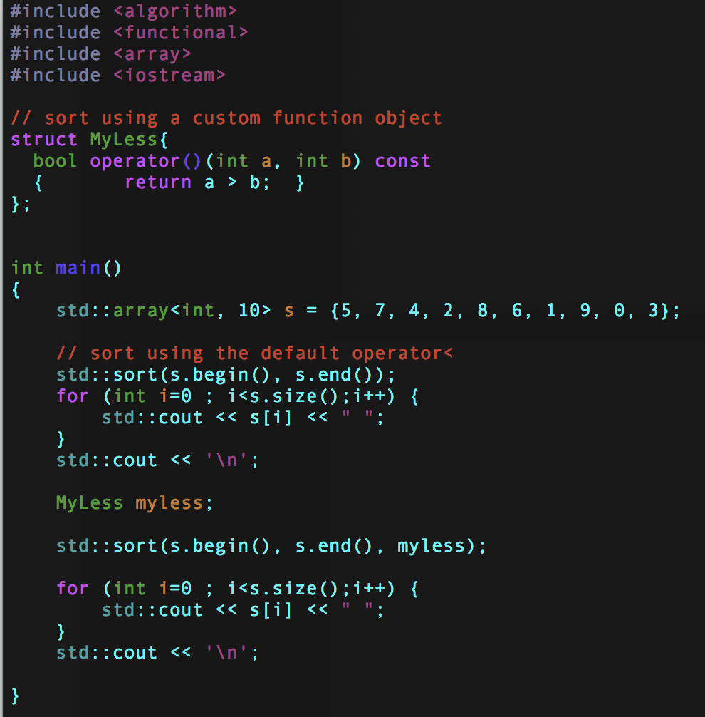

In C++

Slide 19
Heaps
2
5
6
9
7

Slide 20
Recall Priority Queue ADT
A priority queue stores a collection of entries
Typically, an entry is a pair (key, value), where the key indicates the priority
Main methods of the Priority Queue ADT
insert(e) inserts an entry e
removeMin() removes the entry with smallest key
Additional methods
min() returns, but does not remove, an entry with smallest key
size(), empty()
Applications:
Standby flyers
Auctions
Stock market

Slide 21

Recall PQ Sorting
We use a priority queue
Insert the elements with a series of insert operations
Remove the elements in sorted order with a series of removeMin operations
The running time depends on the priority queue implementation:
Unsorted sequence gives selection-sort: O(n²) time
Sorted sequence gives insertion-sort: O(n²) time
Can we do better? Balancing the above
Algorithm PQ-Sort(S, C)
Input sequence S, comparator C for the elements of S
Output sequence S sorted in increasing order according to C
P ← priority queue with comparator C
while ¬S.empty ()
e ← S.front(); S.eraseFront()
P.insert (e, ∅)
while ¬P.empty()
e ← P.removeMin()
S.insertBack(e)

Slide 22
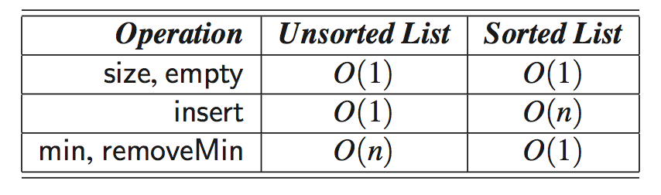
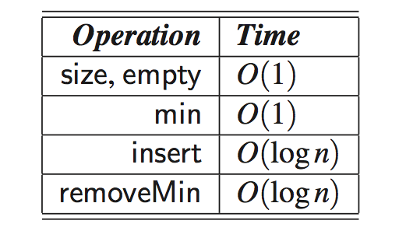
We will have these results soon …
Sequence-based
Heap-based
Key: Where were the “unnecessary repetitions” and “stupidity”?

Slide 23
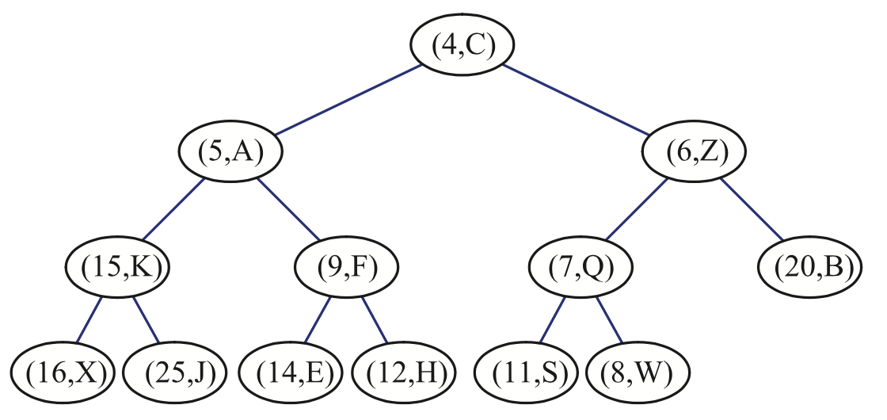
Heap: Overview
A heap is a binary tree storing keys at its nodes and satisfying the following properties:
1. Heap-order property
2. Complete binary tree property
The last node of a heap is the rightmost node of maximum depth
last node

Slide 24
1. Heap-order property
1. Heap-Order: for every internal node v other than the root, key(v) ≥ key(parent(v))
The keys encountered on a path from the root to a leaf T are nondecreasing
A minimum key: always at the root

Slide 25
2. Complete binary tree property
Complete Binary Tree
Roughly speaking, every level, except for the last level, is completely filled, and all nodes in the last level are as far left as possible.
let h be the height of the heap
for i = 0, … , h − 1, there are 2^{i} nodes of depth i
at depth h − 1, the internal nodes are to the left of the external nodes

Slide 26
Height of a Heap of n elements
Theorem: A heap storing n keys has height O(log n)
Proof: (we apply the complete binary tree property)
Let h be the height of a heap storing n keys
Since there are 2^{i} keys at depth i = 0, … , h − 1 and at least one key at depth h, we have n ≥ 1 + 2 + 4 + … + 2^{h−1} + 1
Thus, n ≥ 2^{h} , i.e., h ≤ log n
depth
keys
0
1
1
2
h−1
2^{h−1}
h
1

Slide 27
Heaps and Priority Queues
We can use a heap to implement a priority queue
We say “heap-based PQ implementation”
We store a (key, element) item at each internal node
We keep track of the position of the last node
I am able to know who is the last node in O(1) time
Easy
(2, Sue)
(5, Pat)
(6, Mark)
(9, Jeff)
(7, Anna)

Slide 28
Insertion into a Heap
Method insert of the priority queue ADT corresponds to the insertion of a key k to the heap
The insertion algorithm consists of three steps
Find the insertion node z (the new last node)
How? discussed later
Store k at z
Restore the heap-order property (discussed next)
2
5
z
6
9
7
insertion node
2
5
6
z
9
7
1

Slide 29
Upheap
After the insertion of a new key k, the heap-order property may be violated
Algorithm upheap restores the heap-order property by swapping k along an upward path from the insertion node
Upheap terminates when the key k reaches the root or a node whose parent has a key smaller than or equal to k
Since a heap has height O(log n), upheap runs in O(log n) time
2
1
5
1
5
2
z
z
9
7
6
9
7
6

Slide 30
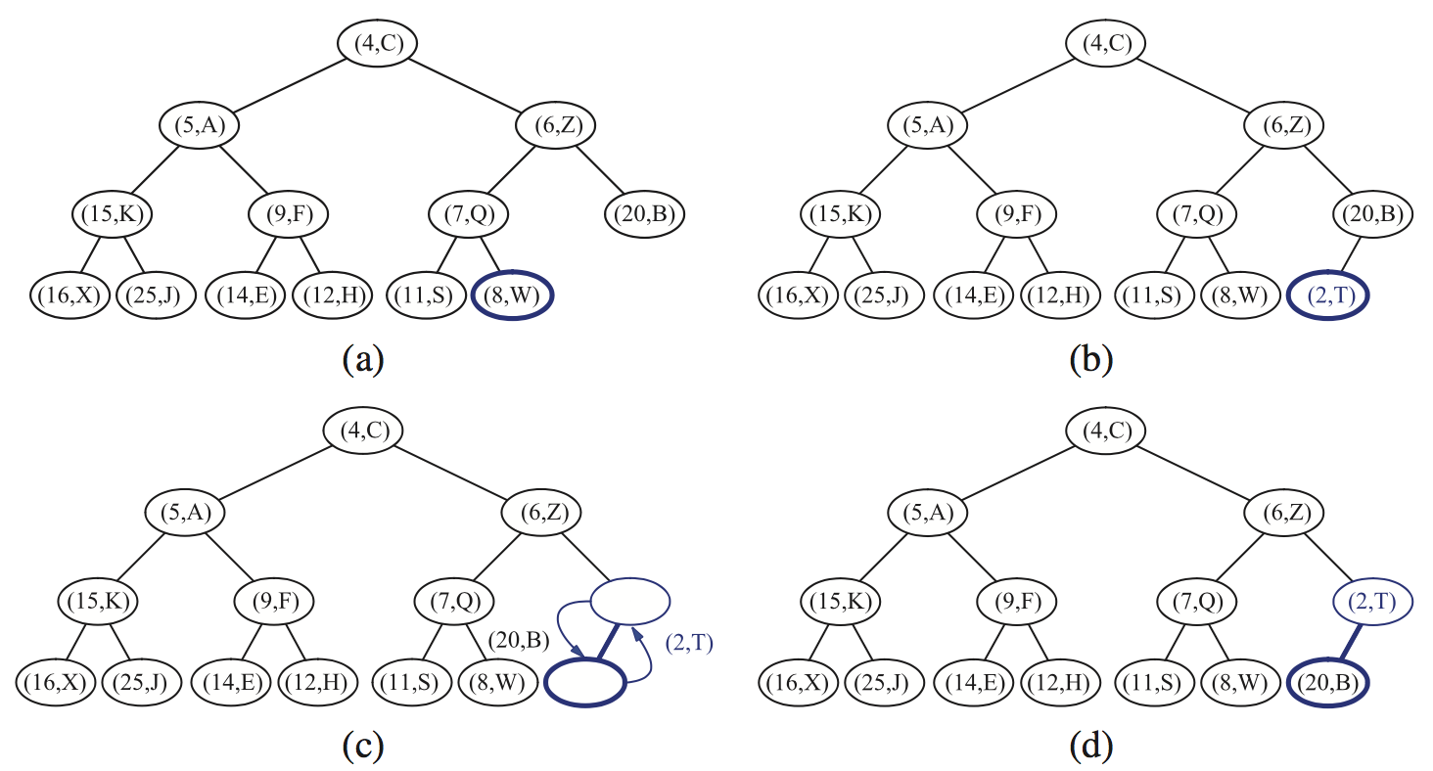
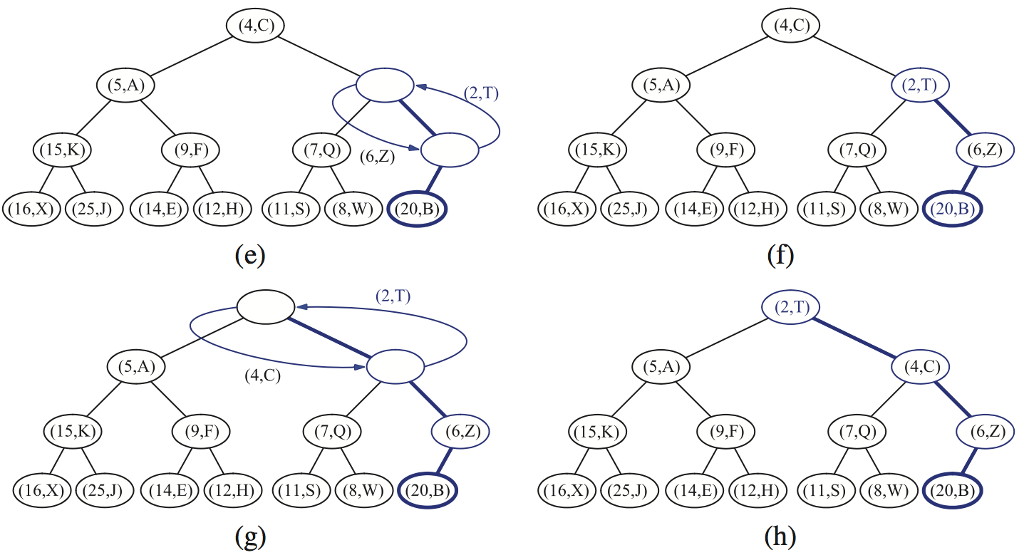
Insert: (2,T)

Slide 31
Removal from a Heap
Method removeMin of the priority queue ADT corresponds to the removal of the root key from the heap
The removal algorithm consists of three steps
Replace the root key with the key of the last node w
Remove w
Restore the heap-order property (discussed next)
2
5
6
w
9
7
last node
7
5
w
6
9
new last node

Slide 32
Downheap
After replacing the root key with the key k of the last node, the heap-order property may be violated
Algorithm downheap restores the heap-order property by swapping key k along a downward path from the root (but which path?)
Upheap terminates when key k reaches a leaf or a node whose children have keys greater than or equal to k
Since a heap has height O(log n), downheap runs in O(log n) time
7
5
5
w
6
7
w
6
9
9

Slide 33
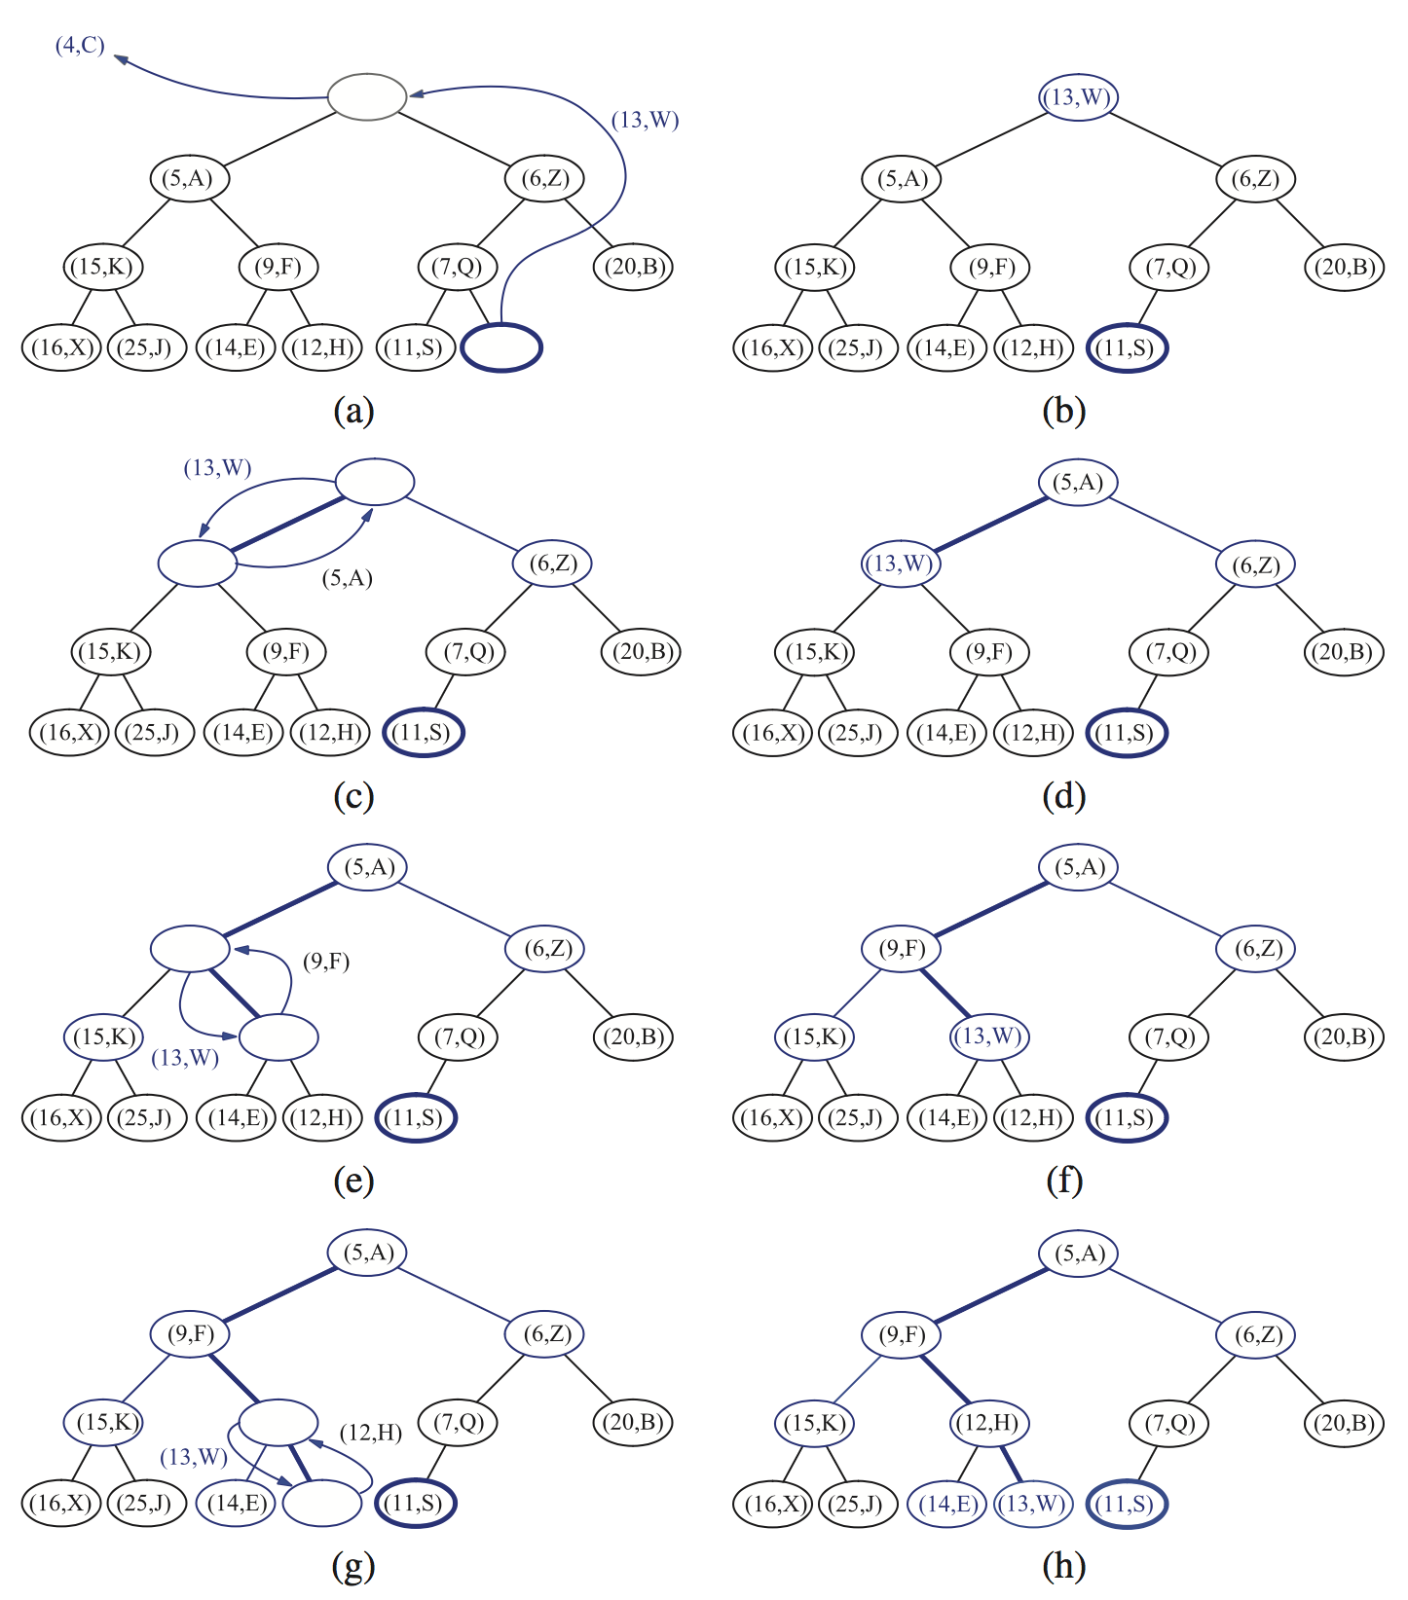
removeMin

Slide 34
Updating the Last Node
How can we find the insertion node (a new last node)?
The insertion node can be found by traversing a path of O(log n) nodes
(1) Go up until a left child or the root is reached
(2) If a left child is reached, go to the right child
(3) Go down left until a leaf is reached
Similar algorithm for updating the last node after a removal

Slide 35
Heap-Sort
Consider a priority queue with n items implemented by means of a heap
the space used is O(n)
methods insert and removeMin take O(log n) time
methods size, empty, and min take time O(1) time
Using a heap-based priority queue, we can sort a sequence of n elements in O(n log n) time
Construction: n insertions
Actual sorting: n removals
The resulting algorithm is called heap-sort
Heap-sort is much faster than quadratic sorting algorithms, such as insertion-sort and selection-sort

Slide 36
Sequence-based vs. Heap-based
Sequence-based
Heap-based
How do we remove “stupid repetition”?
Notes:
Heap은 모든 애들의 순서를 가질 필요는 없다.
가장 작은 애가 누구인가를 잘 유지하고 있으면 되고, 그것을 하기 위한 minimum 구조만 가지고 있으면 된다.
Minimum을 찾는 다는 것이 모든 애들의 순서를 찾는 다는 것을 의미하지는 않는다.

Slide 37
Vector-based Heap Implementation
We can represent a heap with n keys by means of a vector of length n + 1
For the node at rank i
the left child is at rank 2i
the right child is at rank 2i + 1
Links between nodes are not explicitly stored
The cell of at rank 0 is not used
Operation insert corresponds to inserting at rank n + 1
Operation removeMin corresponds to removing at rank n
1
2
2
3
5
6
4
5
9
7
2
5
6
9
7
0
1
2
3
4
5

Slide 38
Merging Two Heaps
We are given two heaps and a key k
We create a new heap with the root node storing k and with the two heaps as subtrees
We perform downheap to restore the heap-order property
3
2
8
5
4
6
7
3
2
8
5
4
6
2
3
4
8
5
7
6

